Slide 1




Slide 2
2 Down- 1 To Go!

Slide 3
William Humphrey
M.S. Aerospace Eng., Case Western Reserve Univ.
10 years Fuel injection test engineer at Delphi
Office: ENG(17)-2523
Phone: 475-5628
Email: waheme@rit.edu
Office Hours: Fri. during class time in this PC lab
Additional hours in my office TBA

Slide 4
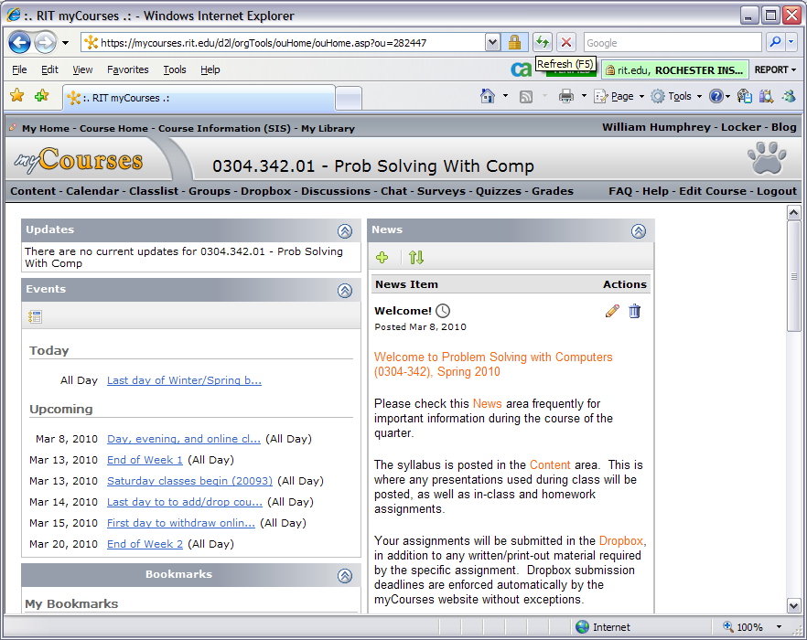
myCourses
(mycourses.rit.edu)
Content
  Syllabus
  Homework posted
  In Class Assignments
  Lecture notes
Dropbox
  Homework submission
Discussion
Grades

Slide 5
Problem Solving with Computers
Problem Solving
Interpreting/ Analyzing
Programming
Documenting
Notes:
You can read the syllabus for all of the gory details…

Slide 6
In short…
Prepare you for a Co-op
  Exposure to engineering and science problems
  Interpret/ Extract info from problem statements
  Professionally document work in a manner that can be easily followed, verified, and reproduced
  Simple Programming
  http://www.rit.edu/kgcoe/mechanical/prospectivestudents/objectivesoutcomes.htm

Slide 7
Computer Topics Covered
Using Excel for Engineering
  Formulas, cell references
  Formatting
  Graphing
  Functions
Programming
  VBA for Excel and Matlab
  If-Then-Else
  Loops
  Arrays

Slide 8
Grading
In-Class Exercises 10%
Daily Quizzes 5%
Homework Assignments 35%
Exams (3, not incl. optional final) 50%

Slide 9
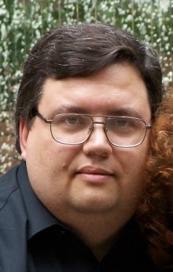
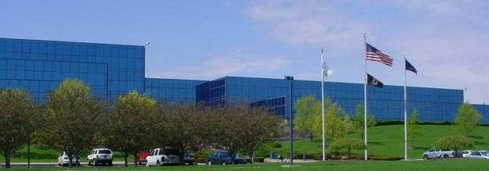


William (Bill) Humphrey
I studied aerospace engineering but ended
up working in automotive engineering for the
last 10 years
I’ve been an adjunct instructor at RIT for 7 years;
a full-time lecturer since Winter 2009-10.
My hobbies: science fiction,
WWII history & games,
kayaking, photography
Technical Center Rochester

Slide 10
In-Class Exercise #1
Put together a Word document that tells your classmates three things about you.
Sample file has been posted on myCourse contents. This would be the same format you should submit your homeworks.
…contd. in next slide

Slide 11
In-Class Exercise #1 (cont.)
Also, include and fill in the following table in the same word document
Upload the word document to myCourses dropbox folder
Excel Experience
Programming Experience
What would you like to learn in this class?

